Slide 1
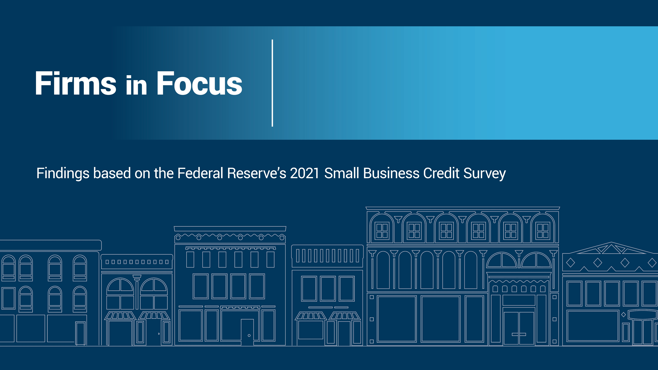
Illinois employer firms

Slide 2
About this report
The Small Business Credit Survey (SBCS) is an annual survey of firms with fewer than 500 employees.
Data in this report represent findings from the 2021 SBCS survey year. The survey was fielded from September 8, 2021, through November 19, 2021.
The findings in this report show data for employer firms only (employer firms are firms with at least one employee in addition to the owner(s)). The charts display findings for this report’s specific subset of the SBCS employer firm data, while the “SBCS employer firm findings” box on each page provides a comparison to the national-level sample of all employer firms.
Estimates on a given slide are redacted if their associated survey question has fewer than 50 observations.

Slide 3
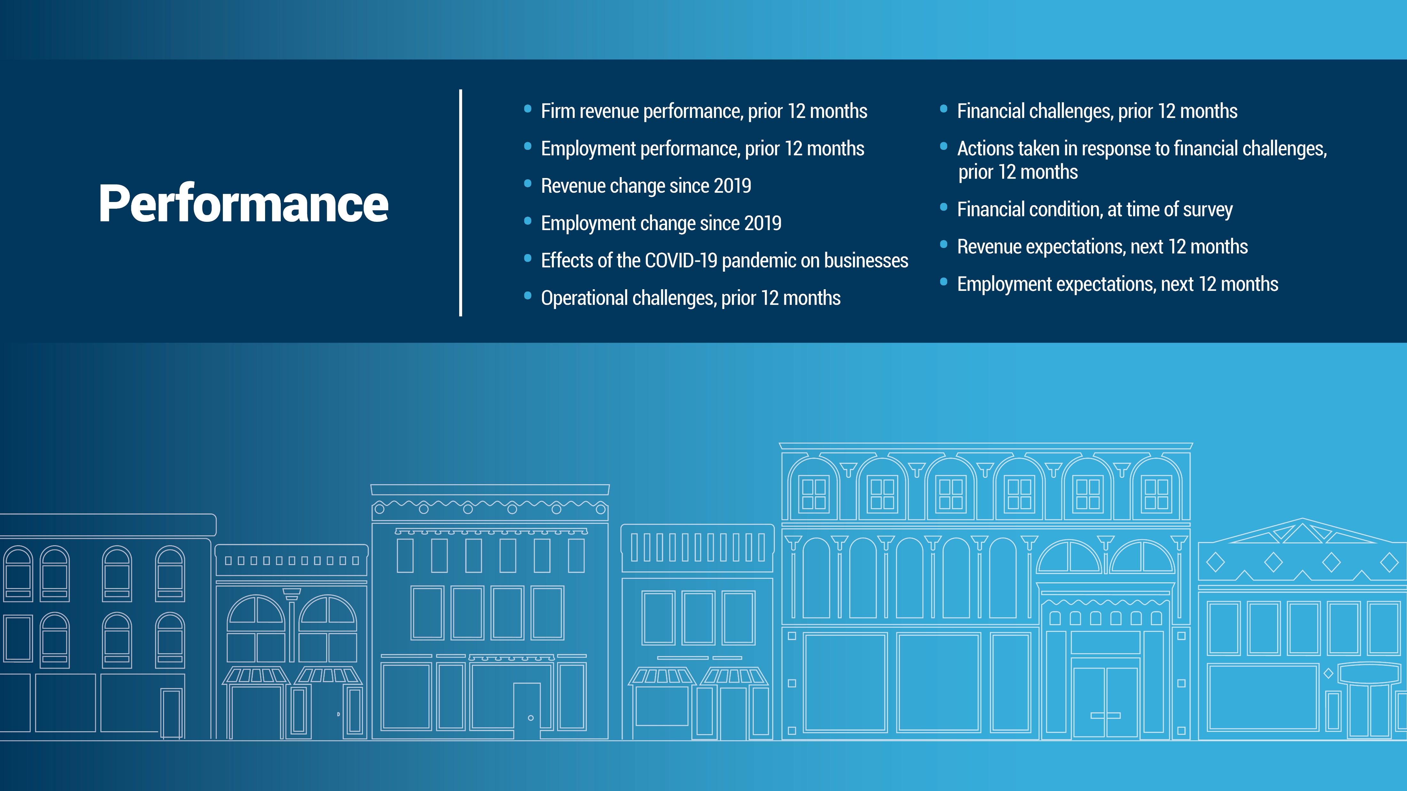

Slide 4
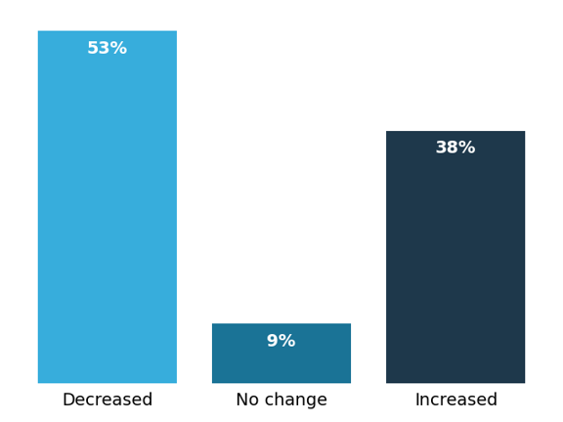
Firm revenue performance, prior 12 months (% of employer firms)
N=397
Firms in Focus: Illinois employer firms
SBCS employer firm findings
Nationally, 48% of employer firms reported a decrease in revenues in the 12 months prior to the survey, and 38% reported an increase.
Notes: Prior 12 months is approximately September–November 2020 through September–November 2021. Percentages may not sum to 100 because of rounding.

Slide 5
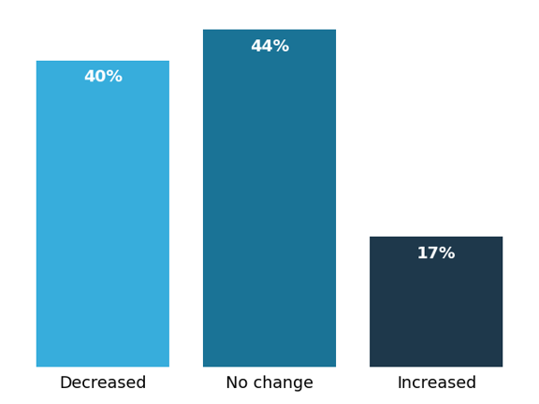
Employment performance, prior 12 months (% of employer firms)
N=401
Firms in Focus: Illinois employer firms
SBCS employer firm findings
Nationally, 33% of employer firms reported a decrease in employment in the 12 months prior to the survey, and 24% reported an increase.
Notes: Prior 12 months is approximately September–November 2020 through September–November 2021. Percentages may not sum to 100 because of rounding.​

Slide 6
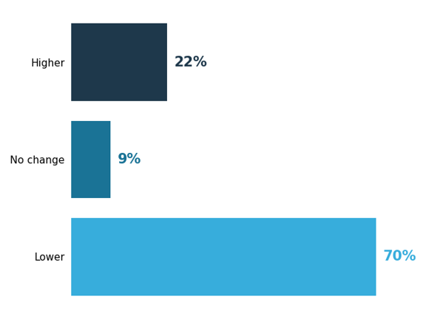
Revenue change since 2019
(% of employer firms open since 2019)
N=286
Firms in Focus: Illinois employer firms
SBCS employer firm findings
Among employer firms in the national SBCS sample, 27% percent reported that revenues are higher than
prepandemic levels compared to 63% of firms that reported revenues are lower.
Notes: Respondents from firms that were established in 2019 or earlier were asked to compare their revenue levels at the time of the survey to the same time in 2019. Percentages may not sum to 100 because of rounding.

Slide 7
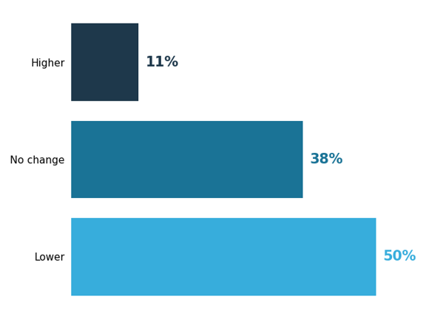
Employment change since 2019
(% of employer firms open since 2019)
N=283
Firms in Focus: Illinois employer firms
SBCS employer firm findings
Among employer firms in the national SBCS sample, 20% reported that employment levels were higher at the time of the survey than prior to the pandemic, while 43% reported that employment levels were lower.
Notes: Respondents from firms that were established in 2019 or earlier were asked to compare their revenue levels at the time of the survey to the same time in 2019. Percentages may not sum to 100 because of rounding.​

Slide 8
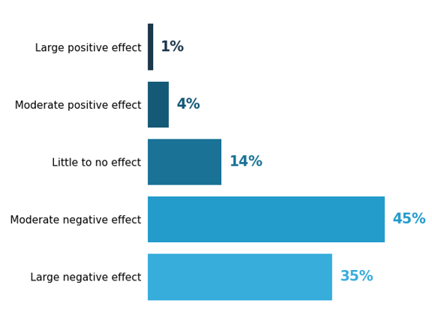
Effects of the COVID-19 pandemic on businesses, at time of survey (% of employer firms)
N=408
Firms in Focus: Illinois employer firms
SBCS employer firm findings
Nationally, just 8% of firms reported a positive effect from the pandemic. In contrast, 33% of employer firms reported the pandemic was having large negative effects on their business at the time of the survey, while 44% reported moderate negative effects.
Note: Percentages may not sum to 100 because of rounding.

Slide 9
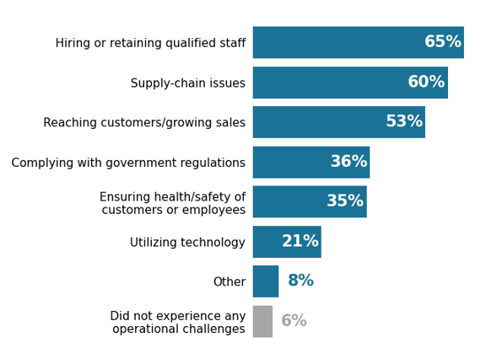
Operational challenges, prior 12 months
(% of employer firms)
N=407
Firms in Focus: Illinois employer firms
SBCS employer firm findings
The top operational challenges for employer firms in the national SBCS sample were hiring or retaining workers (60%), supply-chain issues (60%), and reaching customers/growing sales (53%).
Notes: “Complying with government regulations” includes pandemic-related mandates. “Utilizing technology” includes e-commerce, cyber security, social media, and
website issues. Respondents could select multiple options.

Slide 10
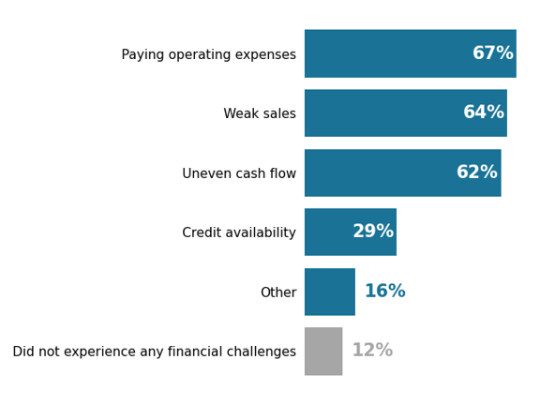
Financial challenges, prior 12 months
(% of employer firms)
N=408
Firms in Focus: Illinois employer firms
SBCS employer firm findings
Nationally, 85% of employer firms reported experiencing one or more financial challenges in the prior 12 months.
Note: Respondents could select multiple options.

Slide 11
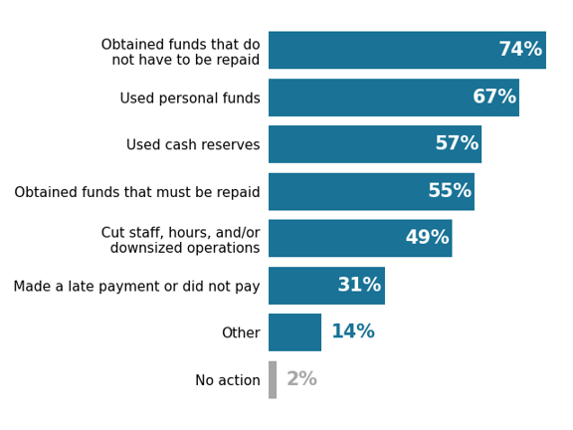
Actions taken in response to financial challenges, prior 12 months (% of employer firms reporting financial challenges)
N=366
Firms in Focus: Illinois employer firms
SBCS employer firm findings
In response to financial challenges, employer firms in the national SBCS sample most often obtained funds that do not have to be repaid, including grants and PPP loans (71%); used the owners’ personal funds (61%); and used cash reserves (56%).
Notes: Respondents could select multiple options. Respondents were instructed to include Paycheck Protection Program (PPP) with funds that do not have to be
repaid only if they received or expected loan forgiveness.

Slide 12
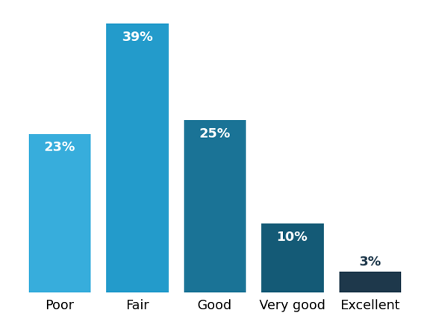
Financial condition, at time of survey
(% of employer firms)
N=409
Firms in Focus: Illinois employer firms
SBCS employer firm findings
Nationally, 21% of employer firms reported their business was in poor financial condition at the time of the survey; 38% were in fair condition. In contrast, a combined 16% reported their business was in very good or excellent condition.
Notes: Self-reported financial condition at time of survey. Percentages may not sum to 100 because of rounding.​

Slide 13
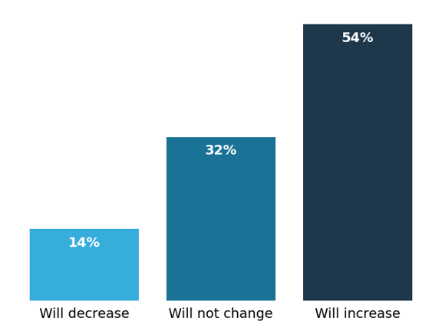
Revenue expectations, next 12 months
(% of employer firms)
N=402
Firms in Focus: Illinois employer firms
SBCS employer firm findings
Among employer firms in the national SBCS sample, 17% expect that revenues will decrease in the next 12 months, while 59% expect revenues will increase.
Notes: Next 12 months is approximately September–November 2021 through September–November 2022. Percentages may not sum to 100 because of rounding.​

Slide 14
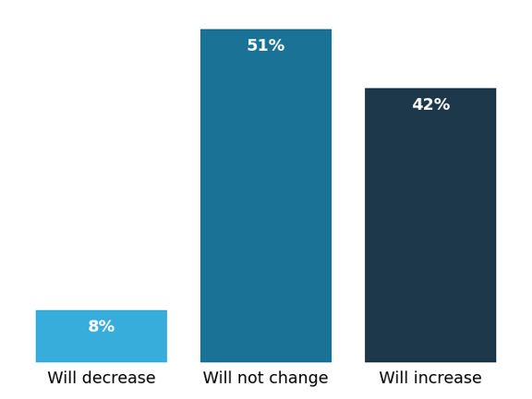
Employment expectations, next 12 months
(% of employer firms)
N=401
Firms in Focus: Illinois employer firms
SBCS employer firm findings
Among the national SBCS sample, 10% of employer firms expect that their employment will decrease in the next 12 months, while 41% expect their employment will increase.
Notes: Next 12 months is approximately September–November 2021 through September–November 2022. Percentages may not sum to 100 because of rounding.​

Slide 15
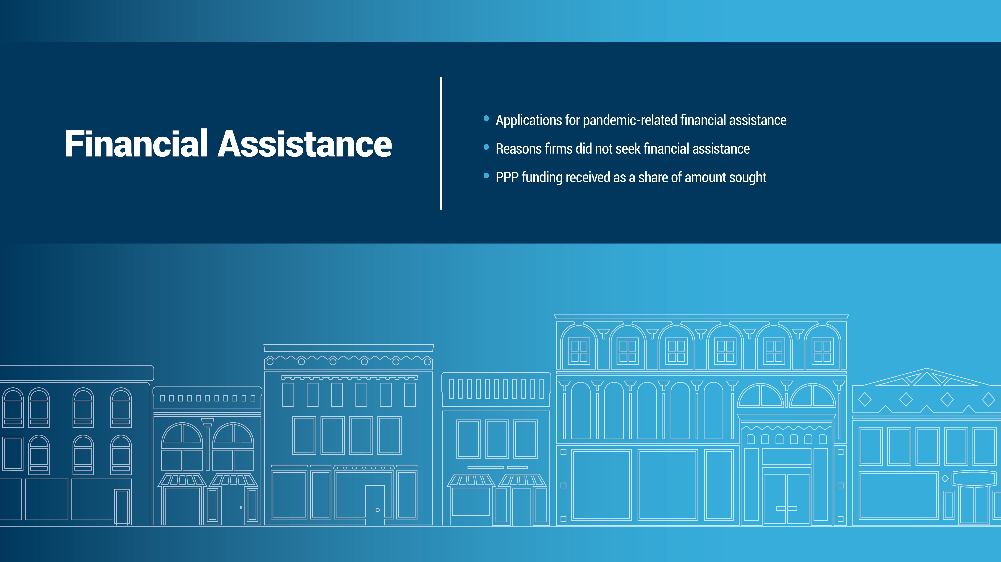

Slide 16
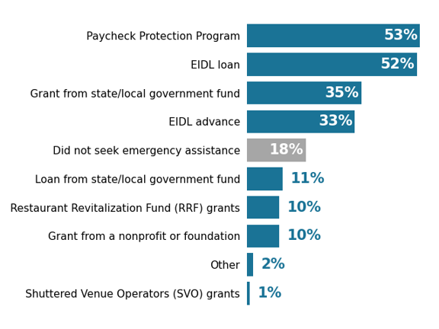
Applications for pandemic-related financial assistance (% of employer firms)
N=402
Firms in Focus: Illinois employer firms
SBCS employer firm findings
Nationally, 23% of firms did not seek financial assistance; therefore, 77% applied for some type of funding. The most common forms of financial assistance that firms sought were EIDL (48%) and PPP (47%).
Notes: The Paycheck Protection Program (PPP), Economic Injury Disaster Loan (EIDL), and Restaurant Revitalization Fund (RRF) are administered by the US Small Business Administration. Respondents could select multiple options.

Slide 17
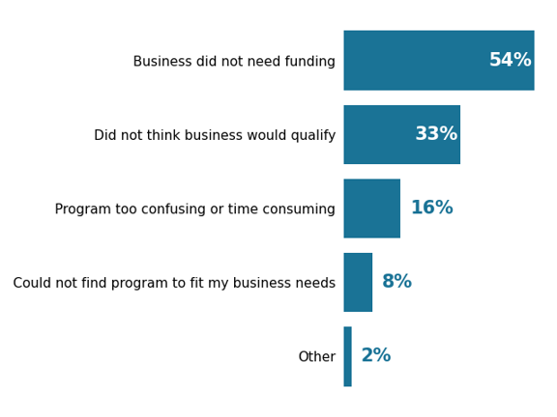
Reasons firms did not seek financial assistance
(% of employer firms that did not apply for assistance)
N=61
Firms in Focus: Illinois employer firms
SBCS employer firm findings
Of firms in the national SBCS sample that did not seek financial assistance, 44% said they did not expect their business would qualify; 36% did not apply because their business did not need funding.
Note: Respondents could select multiple options.

Slide 18
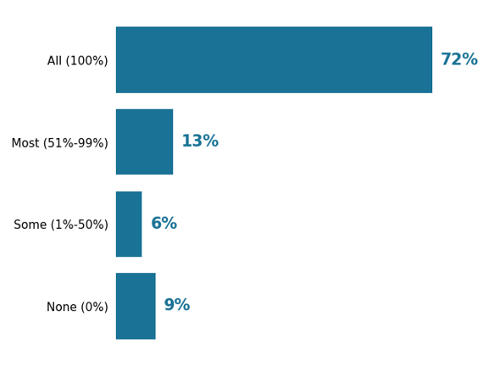
PPP funding received as a share of amount sought (% of employer firm PPP applicants)
N=224
Firms in Focus: Illinois employer firms
SBCS employer firm findings
In the national SBCS sample, 67% of PPP applicants received the full amount sought; 10% received none.
Note: Percentages may not sum to 100 because of rounding.

Slide 19
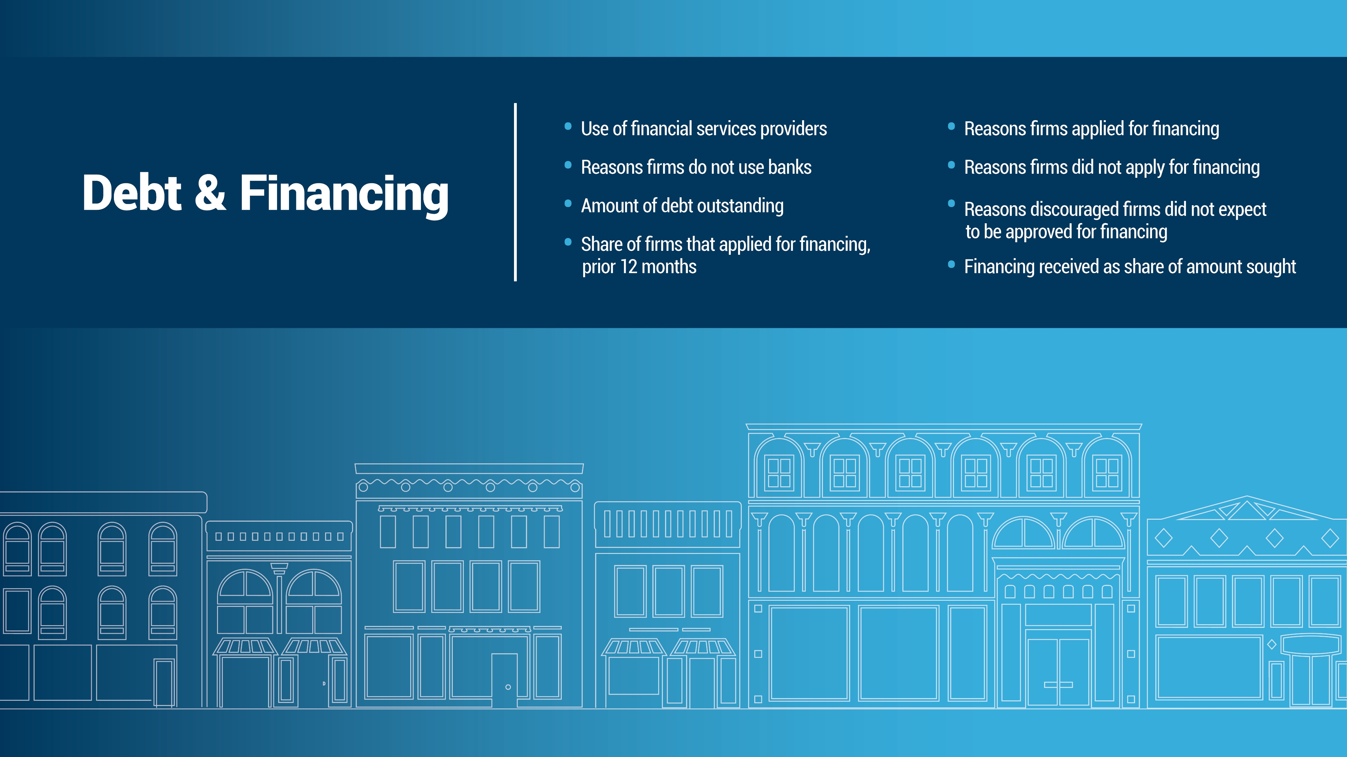

Slide 20
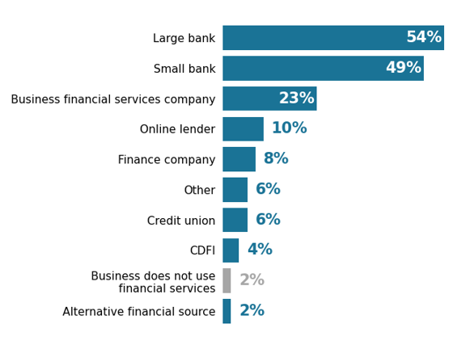
Use of financial services providers
(% of employer firms)
N=407
Firms in Focus: Illinois employer firms
SBCS employer firm findings
Nationally, the most common financial services providers used by employer firms are large banks (56%) and small banks (47%).
Notes: Financial services providers are those at which the firm has an account or uses other financial services, including loans and payments processing. Respondents could select multiple options. See the appendix for SBCS definitions related to financial services providers and lenders.

Slide 21
Reasons firms do not use banks
(% of employer firms that do not use banks for financial services)
Data for this chart are unavailable due to an insufficient sample size.

Slide 22
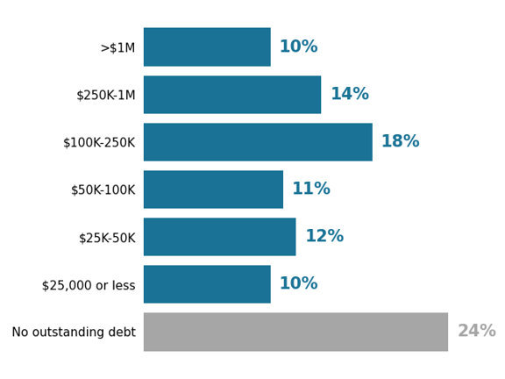
Amount of debt outstanding
(% of employer firms)
N=399
Firms in Focus: Illinois employer firms
SBCS employer firm findings
Nationally, 74% of employer firms had outstanding debt at the time of the survey.
Notes: Respondents were instructed to exclude loans they expected would be forgiven from their outstanding debt (for example, PPP loans). Percentages may not sum to 100 because of rounding.

Slide 23
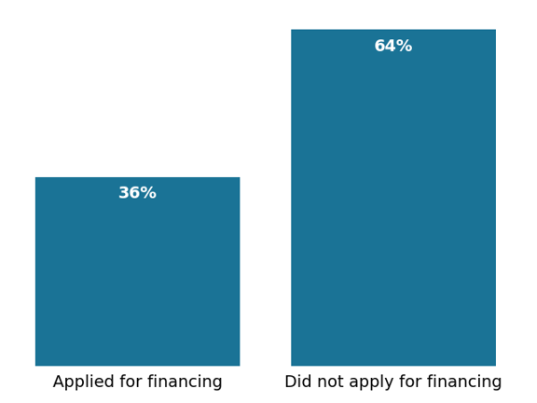
Share of firms that applied for financing, prior 12 months (% of employer firms)
N=401
Firms in Focus: Illinois employer firms
SBCS employer firm findings
Among employer firms in the national SBCS sample, 34% applied for financing in the prior 12 months. The other 66% were nonapplicants, meaning they had not applied for new financing in the prior 12 months.
Note: Excludes applications for pandemic-related financial assistance.

Slide 24
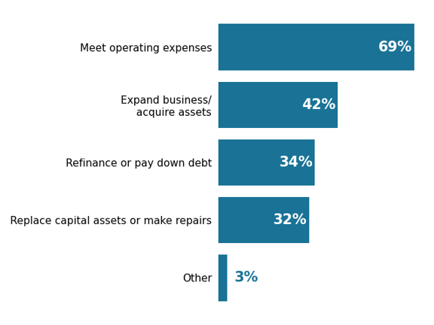
Reasons firms applied for financing
(% of employer applicants)
N=141
Firms in Focus: Illinois employer firms
SBCS employer firm findings
Employer firms in the national SBCS sample that applied for financing most often did so to meet operating expenses (62%) and/or to expand their business (41%).
Note: Respondents could select multiple options.

Slide 25
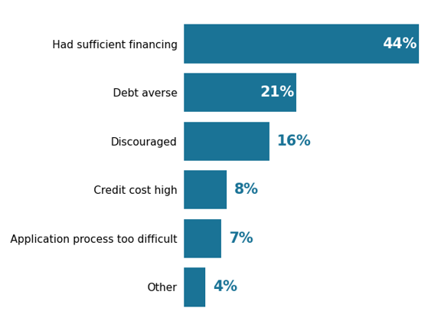
Reasons firms did not apply for financing
(% of employer applicants)
N=247
Firms in Focus: Illinois employer firms
SBCS employer firm findings
Nationally, among firms that did not apply for financing in the prior 12 months, 54% needed funds but chose not to apply because they were averse to taking on debt, were discouraged about their chance of approval, or had other reasons for not applying. The other 46% reported that they already had sufficient financing.
Notes: Response option “other” includes “credit cost was too high,” “application process was too difficult or confusing,” and “other” reasons. Discouraged firms are those that did not apply for financing because they believed they would be turned down.

Slide 26
Reasons discouraged firms did not expect to be approved for financing (% of discouraged nonapplicants)
Data for this chart are unavailable due to an insufficient sample size.

Slide 27
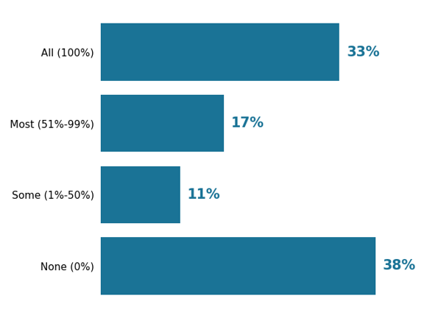
Financing received as share of amount sought (% of employer applicants)
N=136
Firms in Focus: Illinois employer firms
SBCS employer firm findings
Among employer firms in the national SBCS sample that applied for financing, 65% received at least some of the amount sought; 35% received none of what they sought.
Notes: Percentages may not sum to 100 because of rounding. Excludes pandemic-related financial assistance applications.

Slide 28
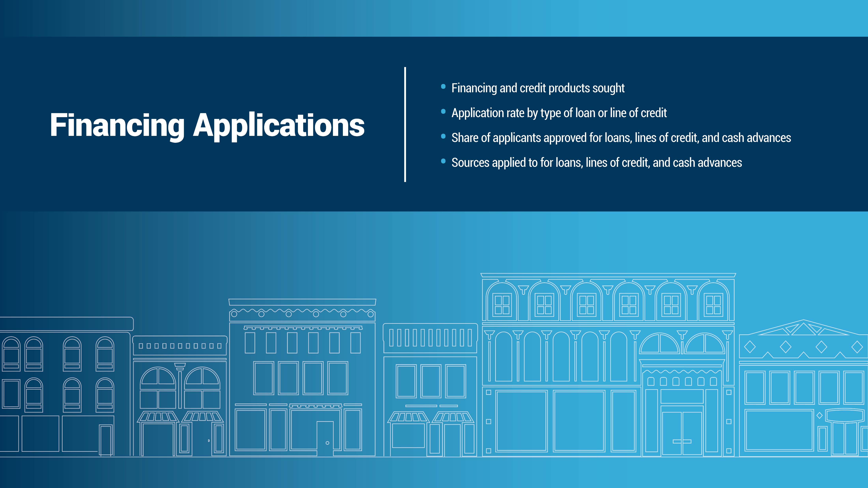

Slide 29
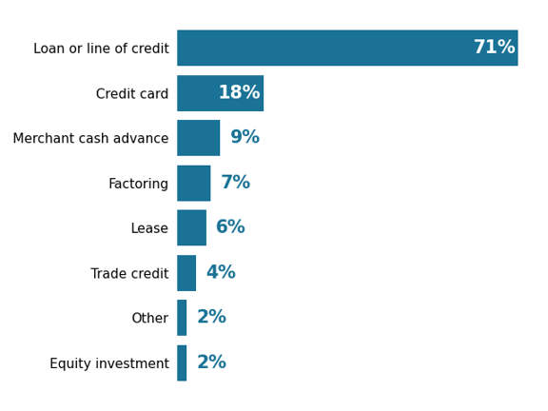
Financing and credit products sought
(% of employer applicants)
N=136
Firms in Focus: Illinois employer firms
SBCS employer firm findings
Nationally, 76% of employer firms that applied for financing sought a loan or line of credit.
Notes: Respondents could select multiple options. Excludes pandemic-related financial assistance applications.

Slide 30
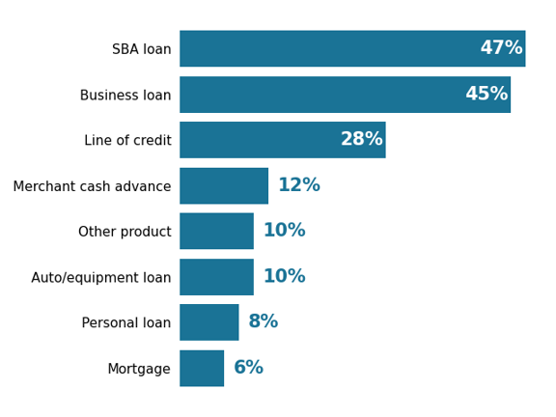
Application rate by type of loan or line of credit (% of loan or line of credit applicants)
N=98
Firms in Focus: Illinois employer firms
SBCS employer firm findings
Among employer firms in the national SBCS sample that sought loans or lines of credit, SBA loans, business loans, and business lines of credit were the most common products.
Notes: Respondents could select multiple options. Excludes pandemic-related financial assistance applications.

Slide 31
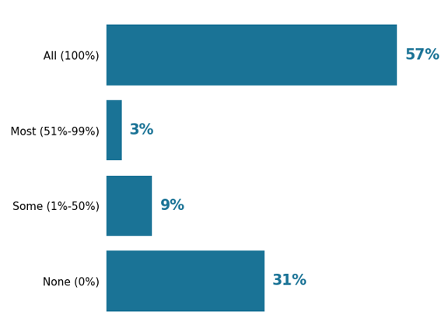
Share of applicants approved for loans, lines of credit, and cash advances (% of loan, line of credit, and cash advance applicants)
N=95
Firms in Focus: Illinois employer firms
SBCS employer firm findings
In the national SBCS sample, 68% of firms that applied for a loan, line of credit, or cash advance were approved for at least some of the financing they sought.
Notes: Excludes pandemic-related financial assistance applications. Percentages may not sum to 100 because of rounding.

Slide 32
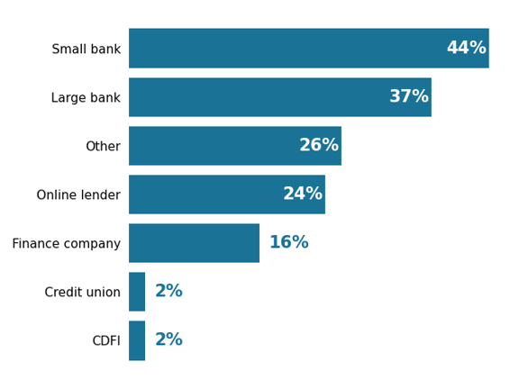
Sources applied to for loans, lines of credit, and cash advances (% of loan, line of credit, and cash advance applicants)
N=98
Firms in Focus: Illinois employer firms
SBCS employer firm findings
Among employer firms in the national SBCS sample that sought loans, lines of credit, or cash advances, their most common sources were large banks (43%), small banks (36%), and online lenders (23%).
Notes: Respondents could select multiple options. Excludes pandemic-related financial assistance applications. See the appendix for SBCS definitions related to financial services providers and lenders.

Slide 33
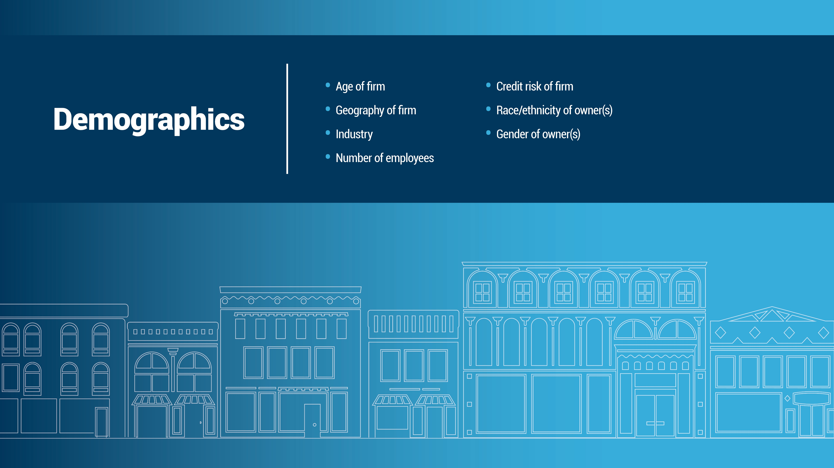

Slide 34
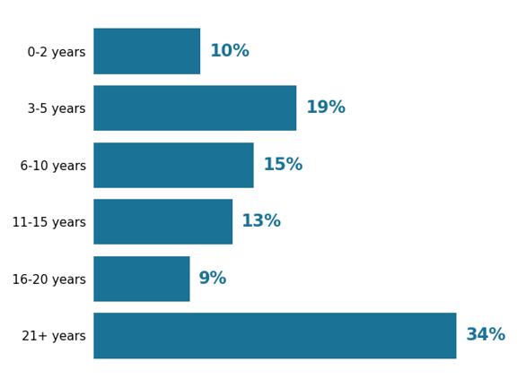
Age of firm (% of employer firms)
N=408
Firms in Focus: Illinois employer firms
SBCS employer firm findings
In the national SBCS sample, 33% of employer firms are newer businesses (0-5 years), and 31% have been in business 21 or more years.
Note: Percentages may not sum to 100 because of rounding.

Slide 35
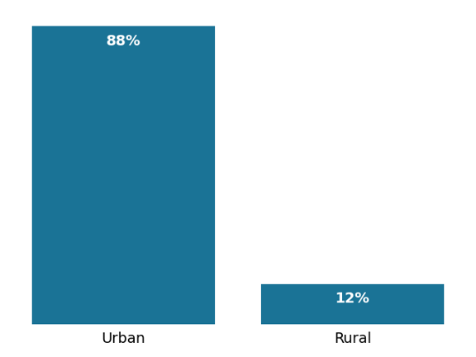
Geography of firm (% of employer firms)
N=409
Firms in Focus: Illinois employer firms
SBCS employer firm findings
In the national SBCS sample, 86% of employer business are located in urban areas; 14% are in rural areas.
Notes: Percentages may not sum to 100 because of rounding. Urban and rural definitions come from the Centers for Medicare and Medicaid Services.

Slide 36
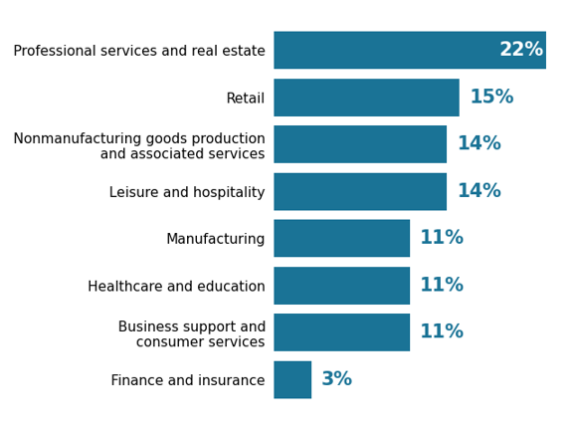
Industry (% of employer firms)
N=408
Firms in Focus: Illinois employer firms
SBCS employer firm findings
The most common industry among employer firms in the national SBCS sample was professional services and real estate, accounting for 20% of firms.
Notes: The nonmanufacturing goods production and associated services category includes industries such as agriculture, construction, wholesale trade, transportation, and warehousing. Percentages may not sum to 100 because of rounding.

Slide 37
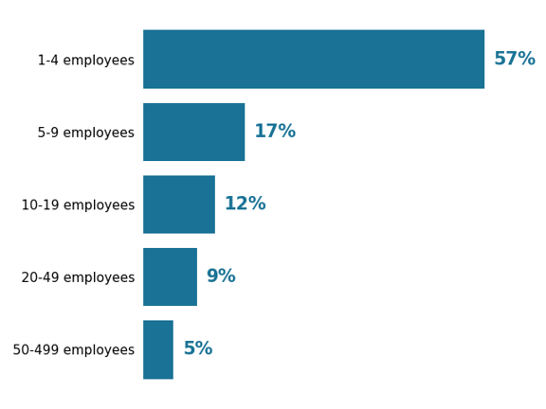
Number of employees (% of employer firms)
N=409
Firms in Focus: Illinois employer firms
SBCS employer firm findings
Nationally, 55% of employer firms have fewer than five employees.
Note: Percentages may not sum to 100 because of rounding.

Slide 38
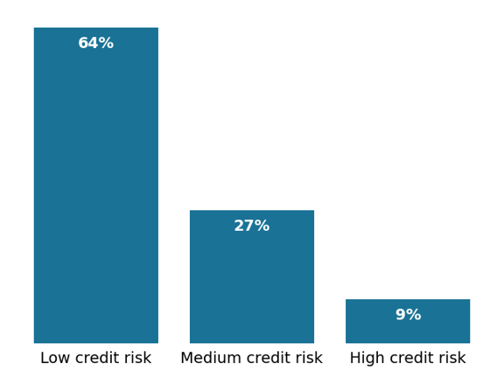
Credit risk of firm (% of employer firms)
N=296
Firms in Focus: Illinois employer firms
SBCS employer firm findings
In the national SBCS sample, 69% of employer firms are low credit risk, 25% are medium credit risk, and 6% are high credit risk as determined by their self-reported credit scores.
Notes: Credit risk is determined by the self-reported business credit score or personal credit score, depending on which is used to obtain financing for the business. If a firm uses both, the higher risk rating is used. “Low credit risk” is an 80–100 business credit score or 720+ personal credit score. “Medium credit risk” is a 50–79 business credit score or a 620–719 personal credit score. “High credit risk” is a 1–49 business credit score or a <620 personal credit score. Percentages may not sum to 100 because of rounding.

Slide 39
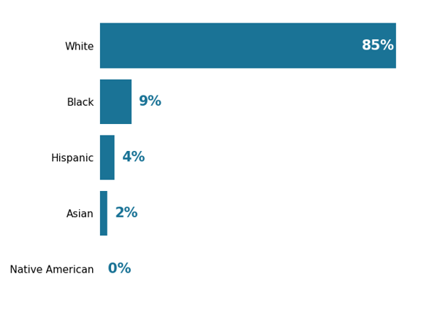
Race/ethnicity of firm owner(s)
(% of employer firms)
N=408
Firms in Focus: Illinois employer firms
SBCS employer firm findings
In the national SBCS sample, 83% of employer firms are white owned, 10% are Asian owned, 6% are Hispanic owned, 2% are Black owned, and less than 1% are Native American owned.
Note: Percentages may not sum to 100 because of rounding.

Slide 40
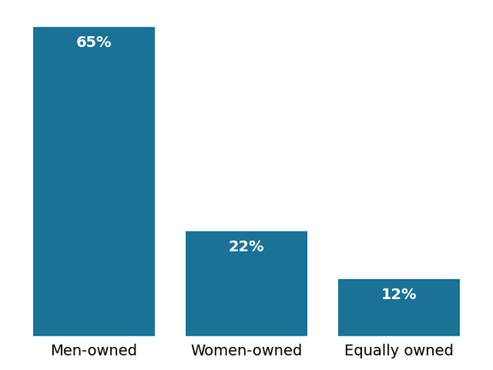
Gender of owner(s) (% of employer firms)
N=409
Firms in Focus: Illinois employer firms
SBCS employer firm findings
In the national SBCS sample, 21% of employer firms are women owned.
Note: Percentages may not sum to 100 because of rounding.

Slide 41
Appendix: Employer firm performance and financing by owner characteristics
Performance
Financing
Note: SBCS lender and industry definitions are available in the appendix slides.

Slide 42
Appendix: Employer firm performance and financing by business characteristics
Performance
Financing
Note: SBCS lender and industry definitions are available in the appendix slides.

Slide 43
Appendix: Employer firm performance and financing by state
Performance
Financing
Note: SBCS lender and industry definitions are available in the appendix slides.

Slide 44
Appendix: Employer firm performance and financing by state (cont.)
Performance
Financing
Note: SBCS lender and industry definitions are available in the appendix slides.

Slide 45
Appendix: Definitions for financial services providers and lenders
Questions in the SBCS ask respondents about their use of and experiences with lenders and other financial services providers. Because respondents may not have a uniform understanding of the terms used in the SBCS, the questionnaire provides examples and explanatory information about the response options. Examples vary between questions to convey the most relevant services and providers. The financial services providers and lenders referenced in the survey are defined as follows.
Large bank, small bank
Large banks are defined as those with at least $10B in total deposits; small banks are those with less than $10B in total deposits. For applicant questions, respondents are shown a list of large banks operating in their state to assist them with proper classification of their institution.
Finance company
Finance companies are nonbanks that provide loans, leases, and other financial services. Examples provided to respondents vary by question but include mortgage companies, auto finance companies, investment funds, and insurance companies.
Online lender/fintech company
Online lenders/fintech companies are nonbanks that operate online. Examples provided to respondents vary by question but include OnDeck, Kabbage, CAN Capital, PayPal, and Square.
Credit union
Credit unions are nonprofit cooperatives where members can borrow money at competitive rates from pooled deposits.
Community development financial institution (CDFI)
CDFIs are financial institutions that provide credit and financial services to
underserved markets and populations. CDFIs are certified by the CDFI Fund at the US Department of the Treasury.
Financial services company
Financial services companies are nonbank providers of business financial services. Examples include companies that provide payroll processing, merchant services, and accounting services.
Alternative financial source
Examples of alternative financial sources provided to respondents include payday lenders, check-cashing services, pawn shops, and money order/transmission services.

Slide 46
Appendix: Definitions of SBCS industry categories
Business support and consumer services
Includes NAICS codes: 56, 81
Examples of businesses: Barbers, business event planning, cleaning services, repair services, salons, spas, travel agencies
Finance and insurance
Includes NAICS code: 52
Examples of businesses: Loan brokers, portfolio management firms
Healthcare and education
Includes NAICS codes: 61, 62
Examples of businesses: Counseling, day cares, dentists, professional training, sports instruction, tutoring
Leisure and hospitality
Includes NAICS codes: 71, 72
Examples of businesses: Bars, caterers, fitness centers, gyms, hotels, performing arts venues
Manufacturing
Includes NAICS codes: 31, 32, 33
Examples of businesses: Electronics manufacturers, engraving, packaging, print shops, textile manufacturers
Nonmanufacturing goods production
and associated services
Includes NAICS code: 11, 21, 22, 23, 42, 48, 49
Examples of businesses: Construction, farming, logistics, mining, taxis, wholesale suppliers and distributors, warehousing
Professional services and real estate
Includes NAICS codes: 51, 53, 54, 55
Examples of businesses: Book publishers, consulting, notaries, real estate agents, vehicle rentals
Retail
Includes NAICS codes: 44, 45
Examples of businesses: Boutiques, craft stores, ecommerce, grocers, hardware stores

